Slide 1
Multiple disease prediction system under the guidance
Mrs. Baby Anusha Medisetty
Reported By:
J.Shyam Kumar (N180061)
M.Subba Rao (N180505)
L.Harsha Rajesh (N180854)

Slide 2
Abstract
This project aims to develop a comprehensive disease prediction system that focuses on predicting three prevalent medical conditions: Diabetes, Heart disease, and Parkinson's disease. By using various machine learning algorithms, the system will analyze various patient health parameters and medical histories to provide accurate predictions of potential disease risks. The system will be integrated with a user-friendly interface using Streamlit, a popular Python library for creating interactive web applications.

Slide 3
Problem Statment
Many of the existing machine learning models for health care analysis are concentrating on one disease per analysis. For example first is for Diabetes analysis, one for Heart analysis, one for Lung diseases like that. If a user wants to predict more than one disease, he/she has to go through different sites. There is no common system where one analysis can perform more than one disease for prediction.

Slide 4
Introduction
In this digital world, data is an asset, and enormous data was generated in all the fields. Data in the healthcare industry consists of all the information related to patients. Here a general architecture has been proposed for predicting the disease in the healthcare industry. Our project is combination of two machine learning models to predict disease at early stage, we split dataset into training and testing set and we calculate accuracy for the each algorithm. we dumped the model using Python’s Pickle library and created web application using Python’s Streamlit for easy user interaction.

Slide 5
Requirements
Anaconda for jupyter notebook (version 1.7.2 or above)
Spyder Python 3.8
Packages and Libraries
    Numpy
    Pandas
    Sklearn
    Streamlit
    Pickle

Slide 6
Data Collection
For the development of a comprehensive disease prediction system that includes diabetes, heart disease, and Parkinson's disease, data plays a crucial role. Kaggle, a popular platform for data science competitions, offers a wealth of datasets that can be utilized for this purpose.
The first step in the data collection process is to search for relevant datasets related to each disease on Kaggle. Kaggle's search functionality allows us to explore various datasets by keywords, such as “Diabetes," “Heart disease," and "Parkinson's disease."

Slide 7
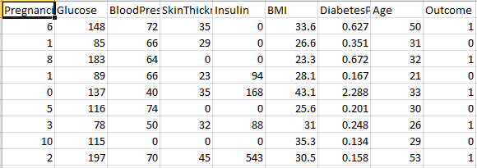
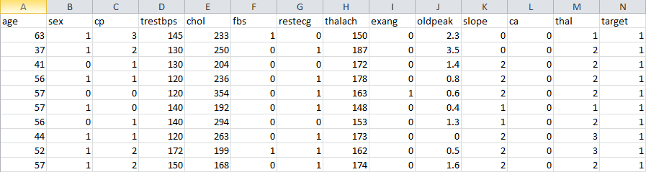
Fig1: Few rows of Diabetes Dataset
Fig2: Few rows of Heart Disease Dataset

Slide 8
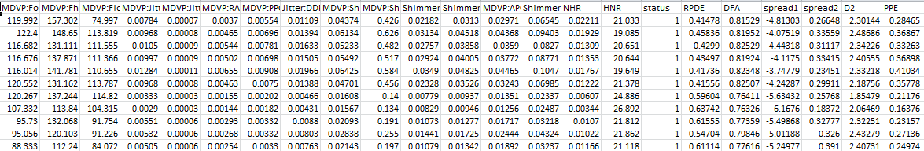
Fig3: Few rows of Parkinson s Dataset

Slide 9
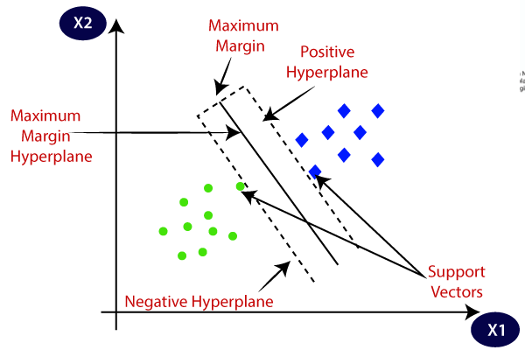
Diabetes Prediction System
Machine Learning Algorithm
  Support Vector Machine
    Support Vector Machine (SVM) is a supervised machine learning algorithm used for both classification and regression. Though we say regression problems as well it’s best suited for classification. The main objective of the SVM algorithm is to find the optimal hyperplane in an N-dimensional space that can separate the data points in different classes in the feature space.

Slide 10
Diabetes Prediction System
Keywords In Algorithm
Hyperplane: Hyperplane is the decision boundary that is used to separate the data points of different classes in a feature space. In the case of linear classifications, it will be a linear equation i.e. wx+b = 0.
Support Vectors: Support vectors are the closest data points to the hyperplane, which makes a critical role in deciding the hyperplane and margin.
Margin: Margin is the distance between the support vector and hyperplane. The main objective of the support vector machine algorithm is to maximize the margin. The wider margin indicates better classification performance.
Kernel: Kernel is the mathematical function, which is used in SVM to map the original input data points into high-dimensional feature spaces, so, that the hyperplane can be easily found out even if the data points are not linearly separable in the original input space. Some of the common kernel functions are linear, polynomial, radial basis function(RBF), and sigmoid.

Slide 11
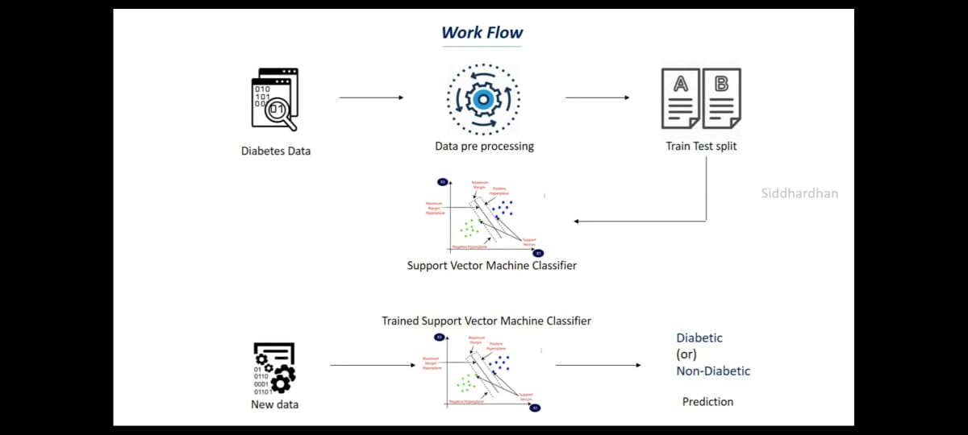
Diabetes Prediction System
Work Flow For Prediction

Slide 12
Diabetes Prediction System
Accuracy Of System
  Accuracy score of the training data : 0.7833876221498371
  Accuracy score of the test data :
    0.7727272727272727
Behaviour Of The Model
  Using Dump function we had saved our model behaviour in “diabetes_model.sav” file.

Slide 13
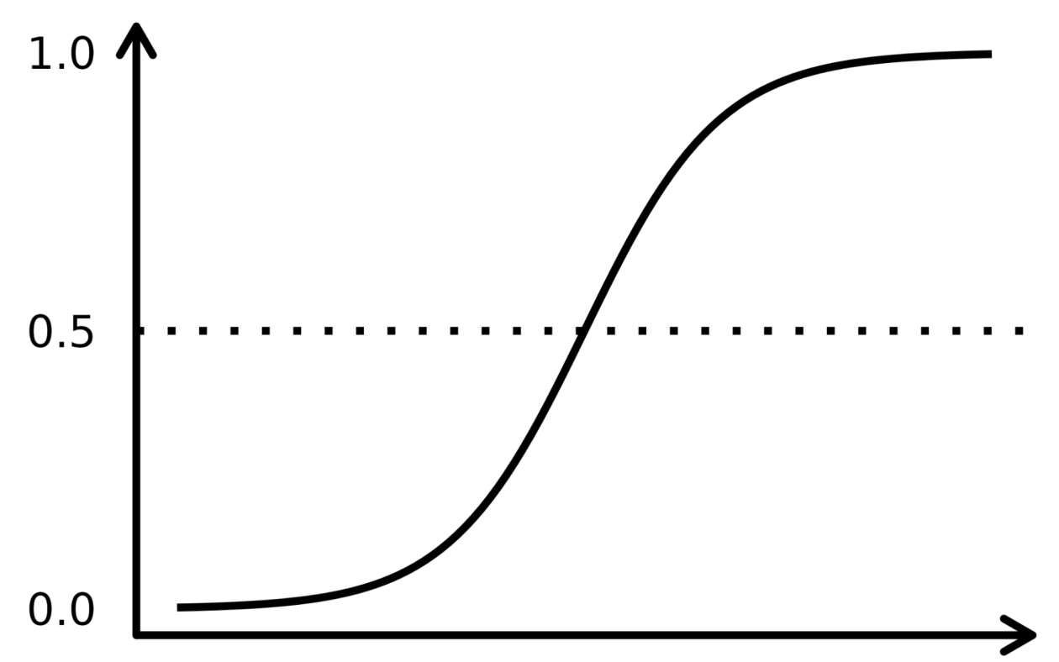
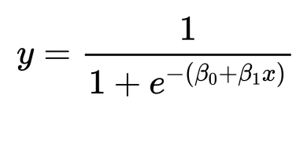
Heart Disease Prediction System
Machine Learning Algorithm
  Logistic Regression
    Logistic regression is a supervised machine learning algorithm mainly used for classification tasks where the goal is to predict the probability that an instance of belonging to a given class.
Sigmoid Function:
Y
S-Curve
THRESHOLD VALUE
X
DATAPOINTS

Slide 14
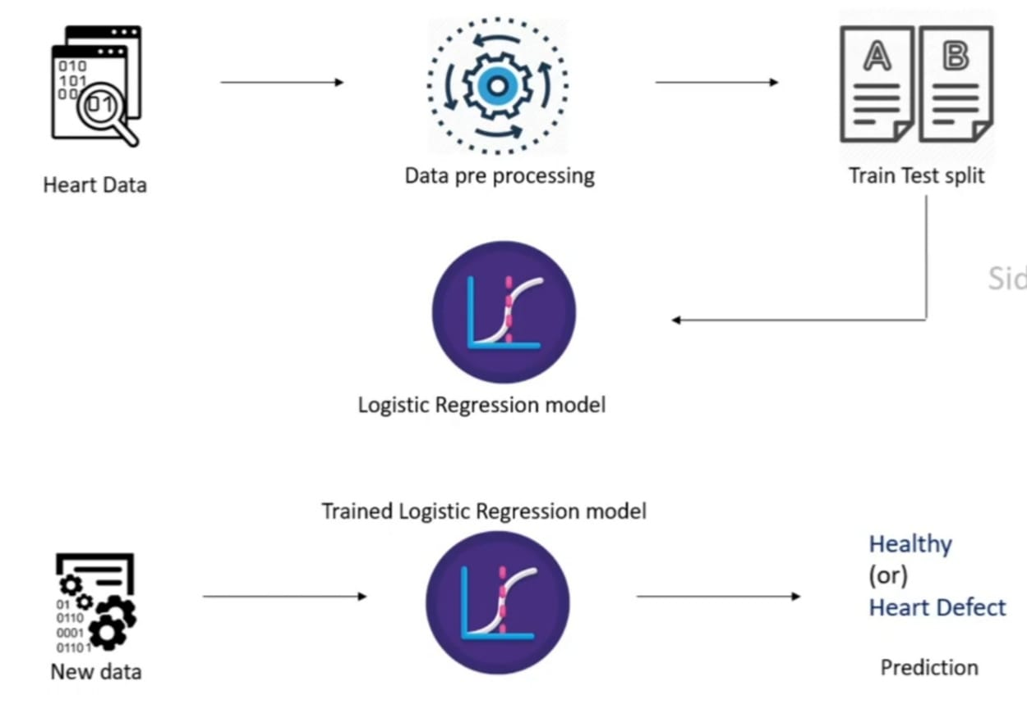
Heart Disease Prediction System
Work Flow For Prediction

Slide 15
Heart Disease Prediction System
Accuracy Of System
  Accuracy score of the training data : 0.8512396694214877
  Accuracy score of the test data :
    0.819672131147541
Behaviour Of The Model
  Using Dump function we had saved our model behaviour in “heart_disease_model.sav” file.

Slide 16
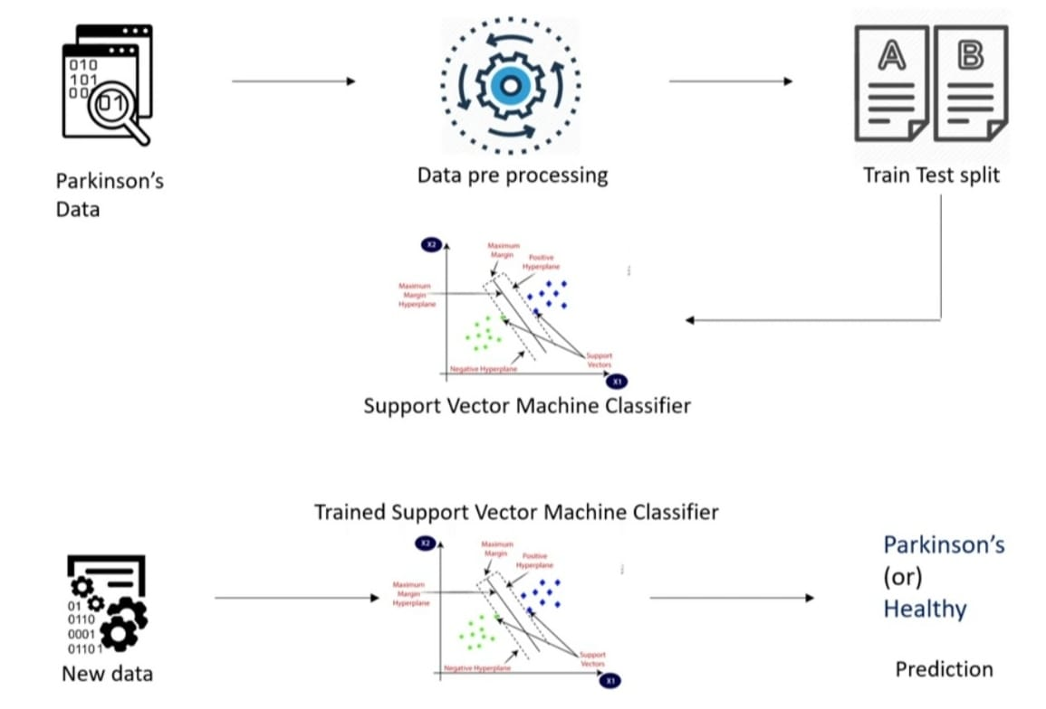
Parkinsons Prediction System
Machine Learning Algorithm
      Support Vector Machine(SVM)
Work Flow For Prediction

Slide 17
Parkinsons Prediction System
Accuracy Of System
  Accuracy score of the training data : 0.8717948717948718
  Accuracy score of the test data :
    0.8717948717948718
Behaviour Of The Model
  Using Dump function we had saved our model behaviour in “parkinsons_model.sav” file.

Slide 18
Interface For The System
Streamlit package:
  Streamlit is a powerful and user-friendly Python library that facilitates the creation of interactive web applications for data science and machine learning projects. It was developed to simplify the process of converting data scripts and models into interactive web applications without the need for complex web development skills.
  Streamlit has gained significant popularity in the data science and machine learning communities due to its simplicity, versatility, and focus on data exploration and visualization. Whether you want to showcase your latest machine learning model, create data dashboards, or explore datasets interactively, Streamlit provides a powerful and accessible tool to accomplish these tasks with ease.

Slide 19
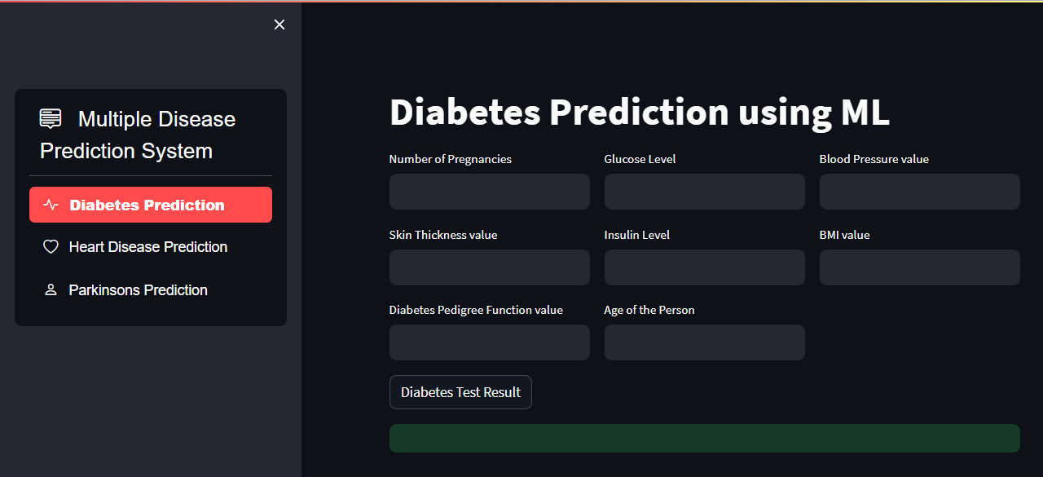
User Interface Of Our System

Slide 20
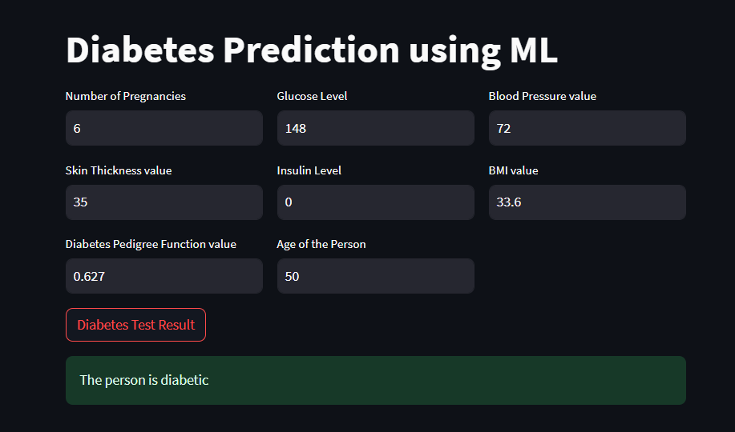
Output Of One Disease

Slide 21
Conclusion
Through extensive data collection and preprocessing, we created a comprehensive dataset encompassing relevant health parameters for diabetes, heart disease, and Parkinson's disease. The chosen machine learning algorithms, SVM and Logistic Regression, have proven to be effective in capturing patterns within the data and making accurate disease predictions.
By leveraging the power of the pickle Python library, we successfully saved the trained machine learning models, ensuring their reusability and easy integration into the Streamlit web application.
In conclusion, the combination of machine learning algorithms, pickle for model saving, and Streamlit for the interface has resulted in accessible disease prediction system.

Slide 22
References
https://www.kaggle.com/datasets/mathchi/diabetes-data-set
https://www.kaggle.com/datasets/johnsmith88/heart-disease-dataset
https://www.kaggle.com/datasets/vikasukani/parkinsons-disease-data-set
IEEE Links For Algorithm
https://ieeexplore.ieee.org/document/8962457
https://ieeexplore.ieee.org/document/708428

Slide 23
THANK YOU

